Slide 1
BHARTI INFOTECH AND SERVICES
Bilaspur , Chhattisgarh
Introduction to Servo motor with Arduino

Slide 2
What is a servo?
A servo-motor is an actuator with a built-in feedback mechanism that responds to a control signal by moving to and holding a position, or by moving at a continuous speed.
DC Motors and Servos
DC Motor
Motion is continuous
Speed controlled by applied voltage
Servo
Capable of holding a position
Speed controlled by delay between position updates
Hybrid of motor, gears and controller.

Slide 3
Control signal is a pulse train
Pulse frequency is fixed
Typical: 20 ms
Pulse width determines position
Typical: 1ms to 2 ms

Slide 4
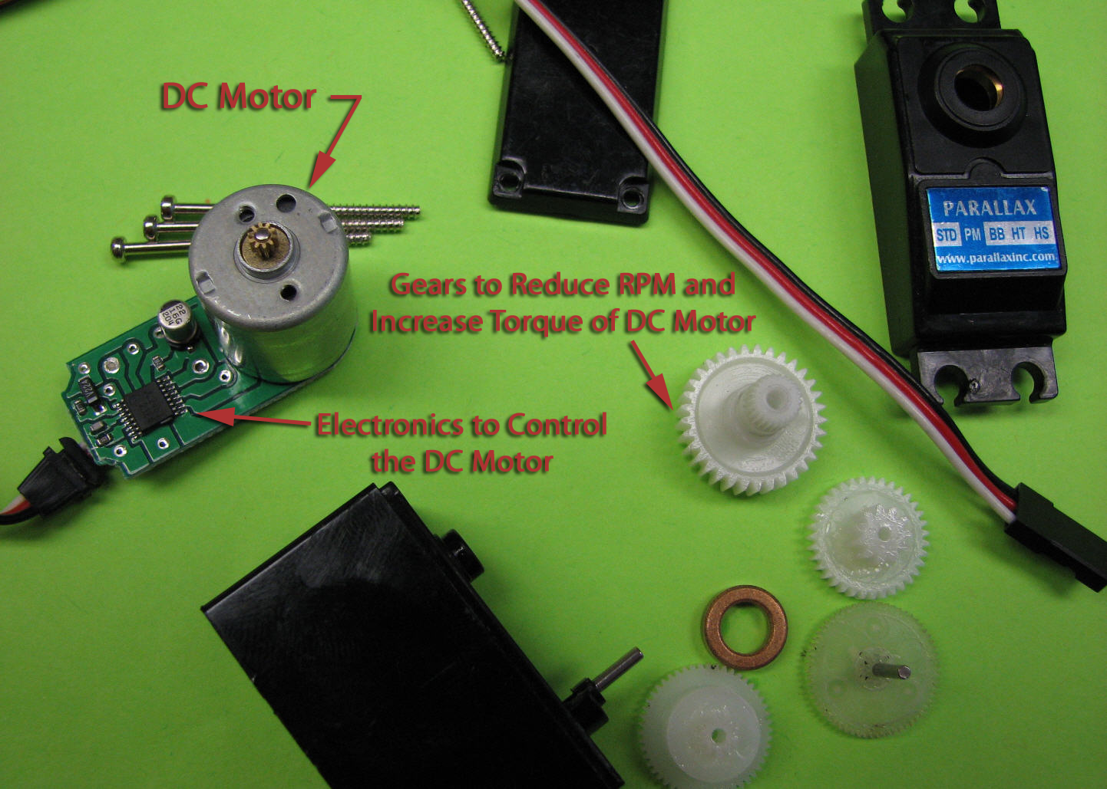
Servo components
Small DC motor
Gearbox with small plastic gears to reduce the RPM and increase output torque
Special electronics to interpret a pulse signal and deliver power to the motor

Slide 5
Servo from the Sparkfun kit
The micro servo from the Sparkfun Inventor’s kit is a conventional servo, i.e. the control signal results in moving the shaft to an angular position.

Slide 6
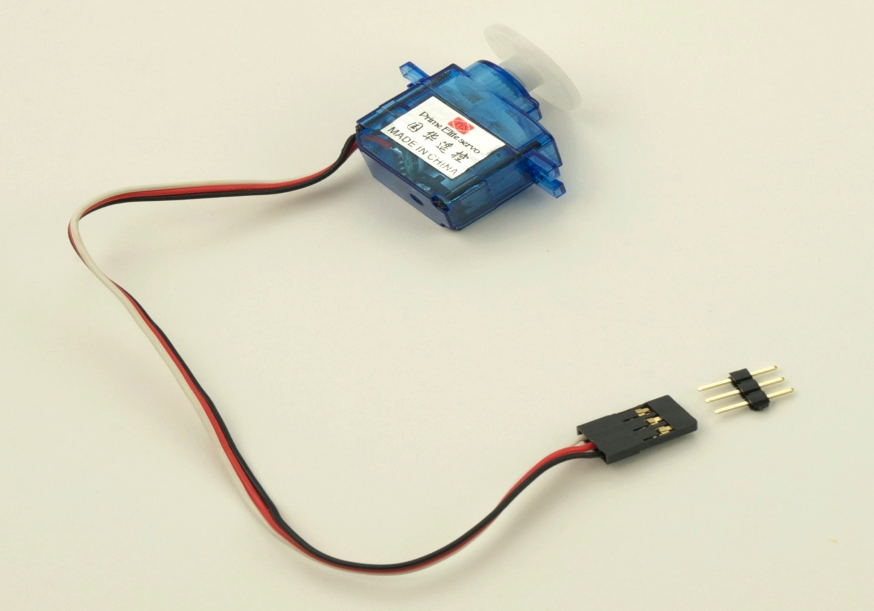
Arduino Servo library handles the details
Must connect servos on pin 9 or pin 10
From the Aduino web site:
“…use of the library disables analogWrite() (PWM) functionality on pins 9 and 10, whether or not there is a Servo on those pins”

